Slide 1
Water Value Analysis
Update 04/03/21

Slide 2
Background
We want to see if/how we can use information about the water stored in reservoirs to say anything about future power prices
In this analysis we will look at how much water has been depleted from reservoirs between the end of October until the start of January and the system price in March
We will use subsets of reservoirs found using clustering

Slide 3
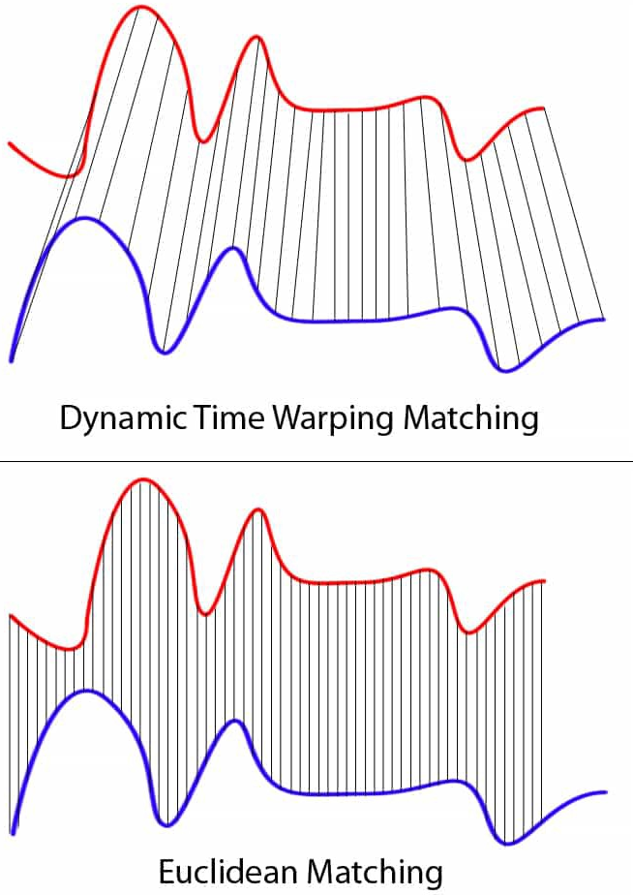
Clustering
Using DTW to group reservoirs with similar
filling level development throughout the year.
Normal Euclidean matching might be too
distorted by geographical features

Slide 4
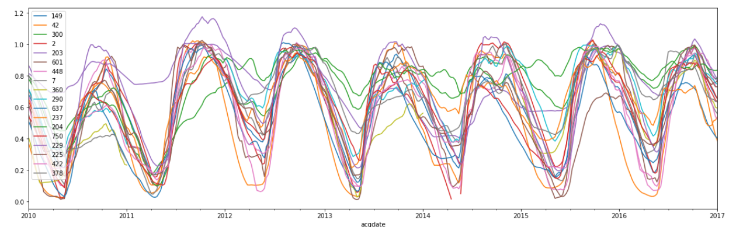
Clustering
Reservoirs used in the analysis. Data provided by NVE.
There are some missing data for most reservoirs

Slide 5
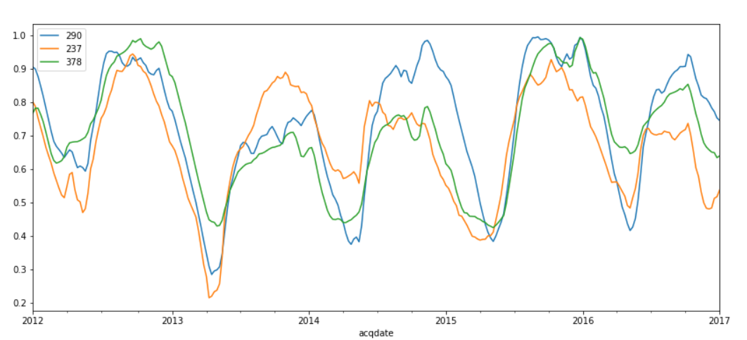
Cluster 1
Vatnedalsvatn (290)
Nesjø-Essandsjø (237)
Svartevatn (378)

Slide 6
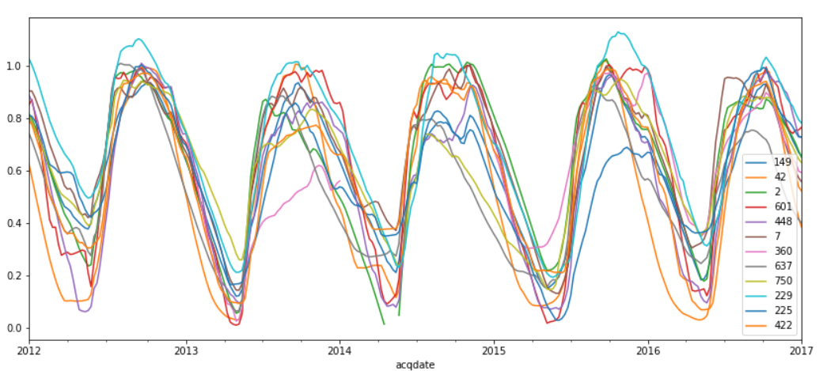
Cluster 2
Strandevatn (149)
Bygdin (42)
Møsvatn (2)
Systenvatn (601)
Tyin (448)
Songavatn (7)
Roskreppfjord (360)
Aursjøen (637)
Altevatn (750)
Sisovatn (229)
Styggevatnet (225)
Nyhellervatn (422)

Slide 7
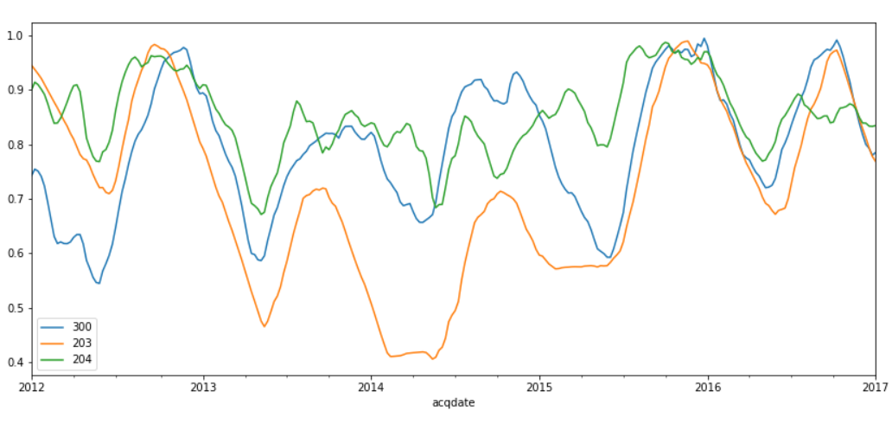
Cluster 3
Blåsjø (300)
Storglomvatn (203)
Akersvatn (204)

Slide 8
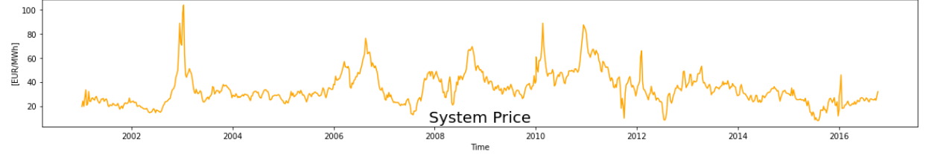
System Price
Absolute price is not important
Price used is Min/Max scaled within period [2010, 2016]

Slide 9
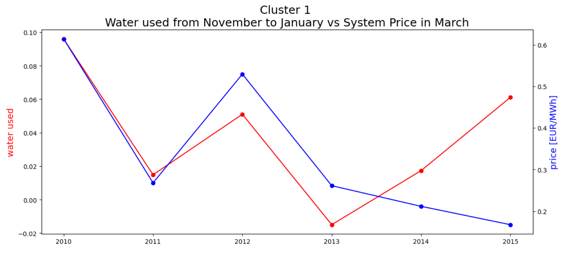
Result Cluster 1

Slide 10
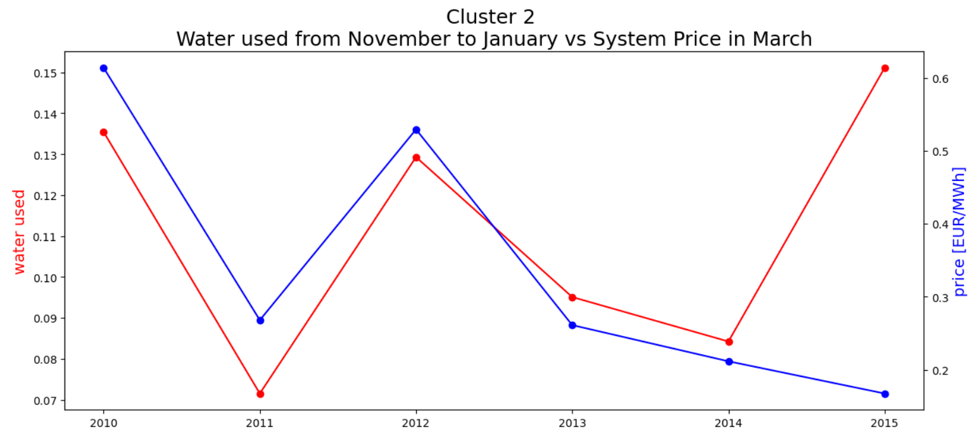
Result Cluster 2

Slide 11
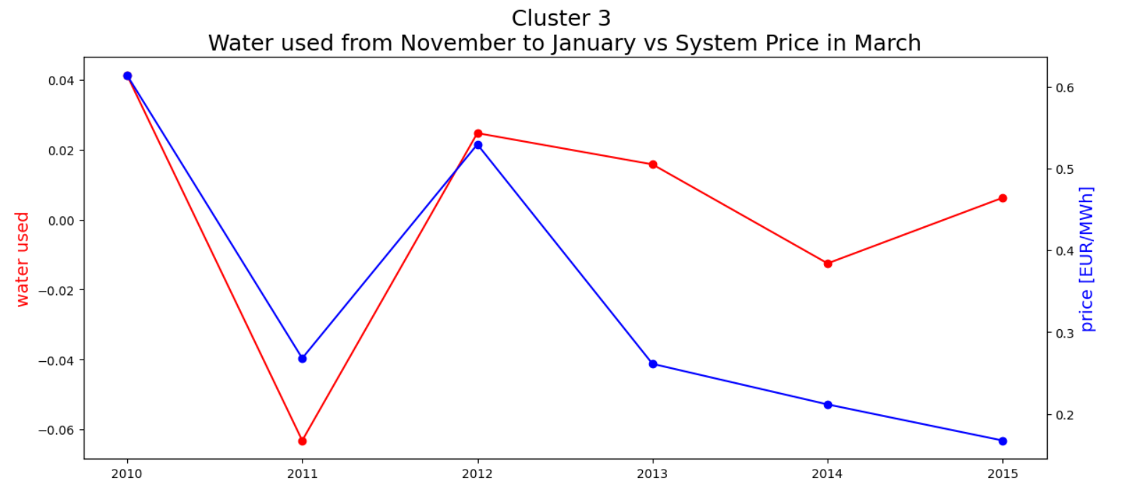
Result Cluster 3

